Slide 1
Navigate Your Restaurant With Precision
Database Management System Lab(CSE0612302)
Uttara University, Department of Computer Science & Engineering

Slide 2
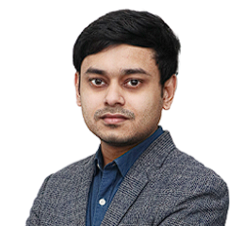
Project Submitted To
Md. Ashraful Kabir
Lecturer & Coordinator, Department of CSE |
Uttara university
Postgraduate - MSc Engg. in Computer Science & Engineering (on going) | BUET
MSc in Computer Science | Jahangirnagar University
BSc in Computer Science & Engineering |
North South University (Cum laude)

Slide 3
Team Roles & Responsibilities
CTO & Database
Administrator
Frontend Lead Developer
Backend Lead Developer
Frontend Developer
Backend Developer
QA Engineer
Fariha Hasnat
ID: 2233081250
Afroza Hossin Sorno
ID: 2233081249
Clement Raka De Costa
ID: 2233081243
Md. Mustafizur Rahman
ID: 2233081453
Debottom Chakma
ID: 2233081529
Md. Maharab Shuvo
ID: 2233081278

Slide 4

Core Features & Project Scope
Order & Billing Management
Table Reservations
Inventory & Supplier Tracking
Payment Gateway Integrations

Slide 5
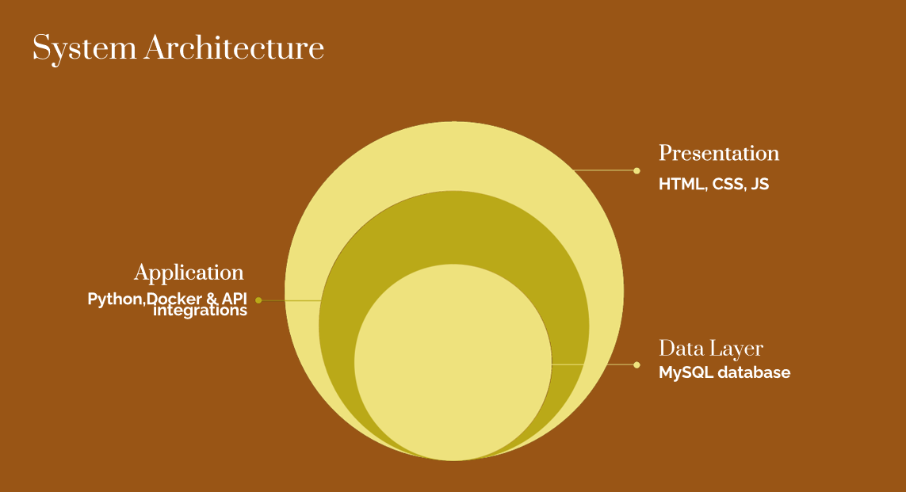

Slide 6
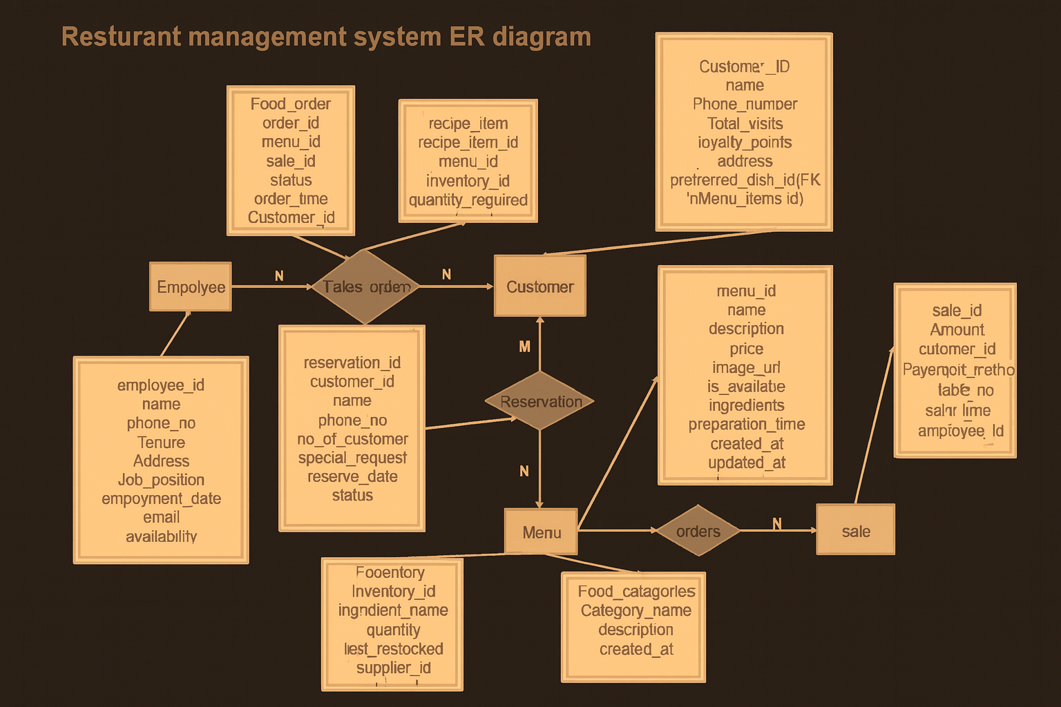

Slide 7
Technologies & Tools
01
Frontend:
HTML,CSS,
JavaScript
02
Backend
Python , Django
03
Database & Server
MySQL
04
Version Control & Collaboration
Git , GitHub

Slide 8
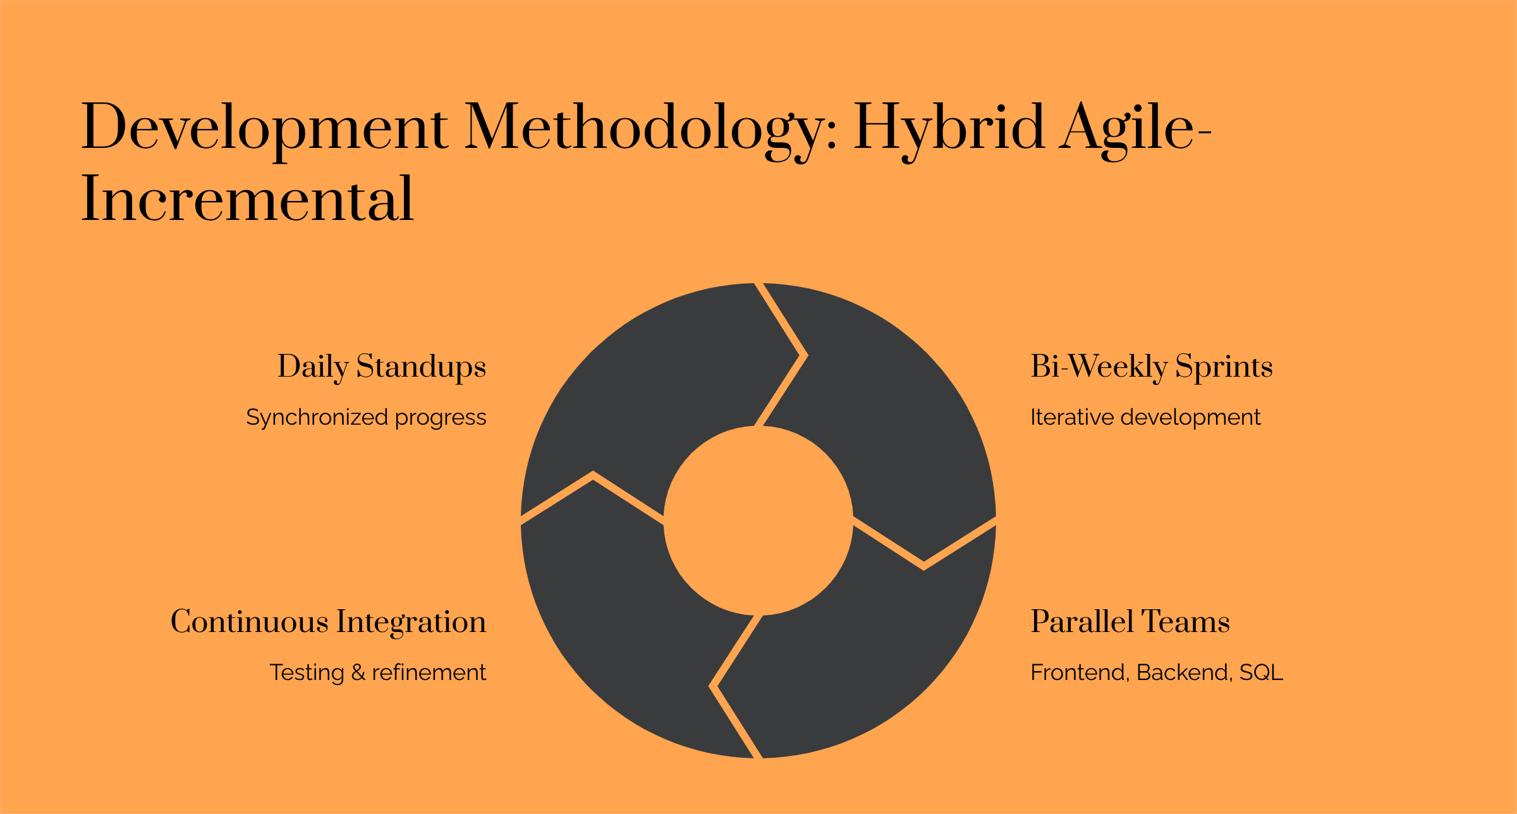

Slide 9
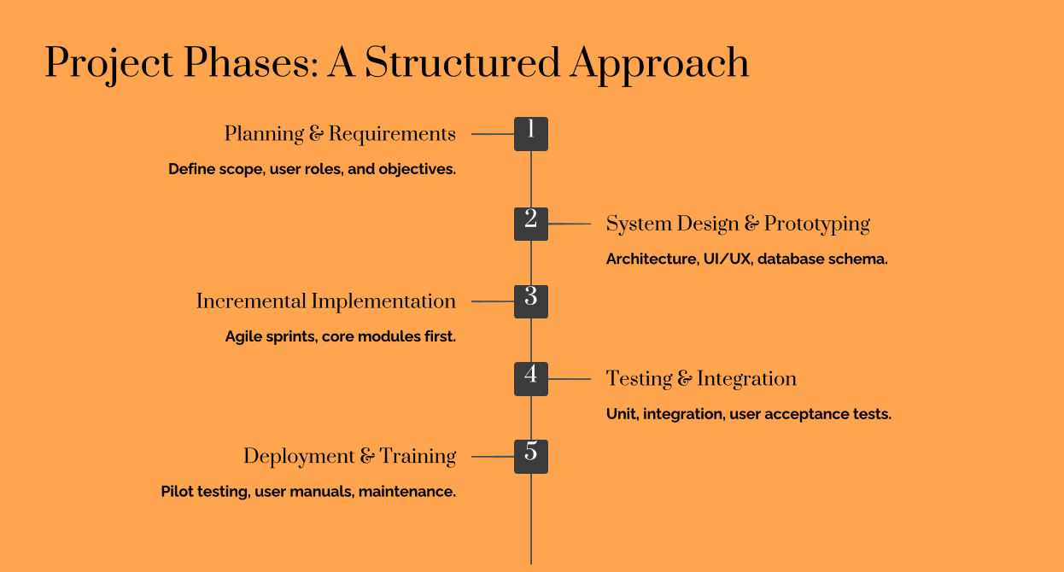

Slide 10
TIMELINE
Requirements
Implementation
Deployment
October 15, 2025
November 10, 2025
November 25, 2025
Design
Testing
October 25, 2025
November 20, 2025

Slide 11

Budget & Resourcing
38%
20%
Smart Workforce Allocation
Cost-Efficient Tech Stack
11%
31%
Training & Support Costs
Hosting & Server Infrastructure

Slide 12
Risks & Safeguards
Scope Expansion
Integration Challenges
Team Coordination Delays
Technical Limitations
Data Security Risks
User Adoption Issues
regular integration testing
Prevent using weekly sprints + daily standups
Control through formal change approval by stakeholders
Reduce using lightweight code
Protect with AES-256 encryption + secure login + backups
User Training Sessions

Slide 13

Future Scope
AI-based predictions
Mobile App Integration
Real-time analytics dashboard
IoT devices for inventory
tracking
Multi-branch cloud deployment
Loyalty & Rewards module
Multilingual support

Slide 14


THANKS!
Do you have any questions? restopilot@gmail.com
+880 1234567890
restopilot.com

